Slide 1
How Debuggers work
Sy Brand
they/them
Principal C++ Developer Advocate, Microsoft
@TartanLlama

Slide 2
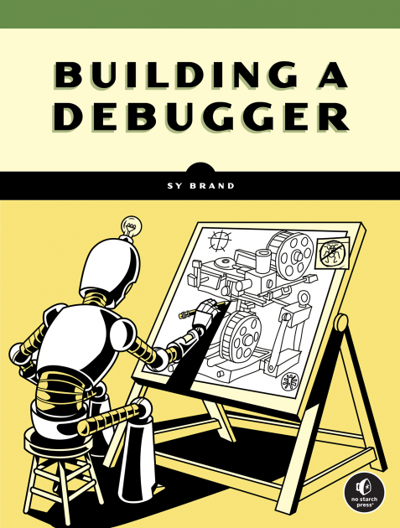
https://nostarch.com/building-a-debugger

Slide 3
What Kind of Debugger?
Native code debuggers
For compiled languages
C, C++, Swift, Rust
Examples:
IDE debugger (Visual Studio, Clion)
Command line debugger (GDB, LLDB)

Slide 4
Agenda
Debug scenario architecture
Manipulating memory
Setting a breakpoint
Reading a variable
Calling a function

Slide 5
Debug scenario architecture

Slide 6
Debugger
Process
Binary
Source Code
Code
Data
Code
Debug Info
Operating System
Hardware

Slide 7
Debugger
Process
Binary
Source Code
Code
Data
Code
Debug Info
Operating System
Hardware

Slide 8
Debugger
Process
Binary
Source Code
Code
Data
Code
Debug Info
Operating System
Hardware

Slide 9
Manipulating memory

Slide 10
Debugger
Process
Binary
Source Code
Code
Data
Code
Debug Info
Operating System
Hardware

Slide 11
Debugger
Process
Binary
Source Code
Code
Data
Code
Debug Info
Operating System
Hardware

Slide 12
Debugger
Process
Binary
Source Code
Code
Data
Code
Debug Info
Operating System
Hardware

Slide 13
System Calls (syscalls)
Functions provided by the operating system to allow user programs to perform privileged operations

Slide 14
ptrace

Slide 15
uint64_t data = ptrace(
PTRACE_PEEKDATA,
pid,
address,
NULL
);

Slide 16
Setting a breakpoint

Slide 17
Set a breakpoint on line 12 of pet_cat.c

Slide 18
Which machine instruction corresponds to that source line?
How do we make the process stop when that machine instruction is executed?

Slide 19
Debug Information
Data generated by the compiler that maps machine code back to the original source code

Slide 20
Debugger
Process
Binary
Source Code
Code
Data
Code
Debug Info
Operating System
Hardware

Slide 21
Debugger
Process
Binary
Source Code
Code
Data
Code
Debug Info
Operating System
Hardware

Slide 22
Debugger
Process
Binary
Source Code
Code
Data
Code
Debug Info
Operating System
Hardware

Slide 23
Debugger
Process
Binary
Source Code
Code
Data
Code
Debug Info
Operating System
Hardware

Slide 24
Which machine instruction corresponds to that source line?
How do we make the process stop when that machine instruction is executed?

Slide 25
89 c6 mov %eax,%esi
48 89 df mov %rbx,%rdi
e8 7e fe ff ff call 1130

Slide 26
89 c6 mov %eax,%esi
cc 89 df int3
e8 7e fe ff ff call 1130

Slide 27
int3
Trigger interrupt
Notify operating system
Signal process to stop
Debugger intercepts signal and reports to user

Slide 28
Reading a variable

Slide 29
Visualise the variable mittens_the_cat

Slide 30
struct cat {
const char* name;
int floofiness;
int age;
};
struct cat mittens = {
"mittens", 10, 3
};

Slide 31
55 55 60 04 00 00 55 55
00 00 00 0a 00 00 00 03

Slide 32
55 55 60 04 00 00 55 55
00 00 00 0a 00 00 00 03

Slide 33
55 55 60 04 00 00 55 55
00 00 00 0a 00 00 00 03

Slide 34
55 55 60 04 00 00 55 55
00 00 00 0a 00 00 00 03

Slide 35
Debugger
Process
Binary
Source Code
Code
Data
Code
Debug Info
Operating System
Hardware

Slide 36
Debugger
Process
Binary
Source Code
Code
Data
Code
Debug Info
Operating System
Hardware

Slide 37
55 55 60 04 00 00 55 55
00 00 00 0a 00 00 00 03

Slide 38
mittens = {
name = "mittens",
floofiness = 10,
age = 3
};

Slide 39
Calling a function

Slide 40
Call the function feed_cat

Slide 41
Step 1: Write a C compiler

Slide 42
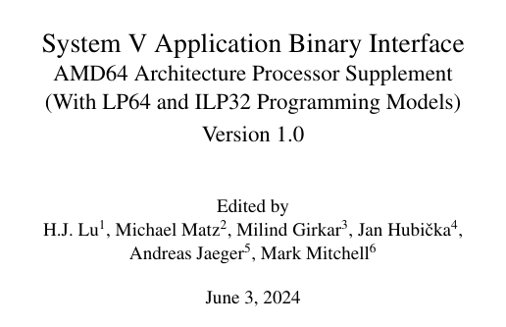
✨
✨
✨
✨
✨
✨
✨
✨
✨
✨
✨
✨

Slide 43
(gdb) expr feed_cat()
Fed cat!
(gdb)

Slide 44
Summary
Debug scenario architecture
Manipulating memory
Setting a breakpoint
Reading a variable
Calling a function

Slide 45
https://nostarch.com/building-a-debugger

Slide 46
Thank you
Sy Brand
they/them
Principal C++ Developer Advocate, Microsoft
@TartanLlama

